Slide 1
Performance analysis of spread spectrum communication system using Simulink and Matlab
Under the guidance of
Dr. Sukla Basu
by
Jyotirmay Maity
Pronab Roy
Digbijoy Mitra
Md. Arif Layek

Slide 2
Spread Spectrum
important encoding method for wireless communications
analog & digital data with analog signal
spreads data over wide bandwidth
makes jamming and interception harder
two approaches, both in use:
  Frequency Hopping
  Direct Sequence
Notes:
Spread spectrum is an increasingly important form of encoding for wireless communications. It it can be used to transmit either analog or digital data, using an analog signal.The basic idea of spread spectrum is to modulate the signal so as to increase significantly the bandwidth (spread the spectrum) of the signal to be transmitted. It was initially developed for military and intelligence requirements. The use of spread spectrum makes jamming and interception more difficult and provides improved reception. The first type of spread spectrum developed is known as frequency hopping. A more recent type of spread spectrum is direct sequence. Both of these techniques are used in various wireless communications standards and products.

Slide 3
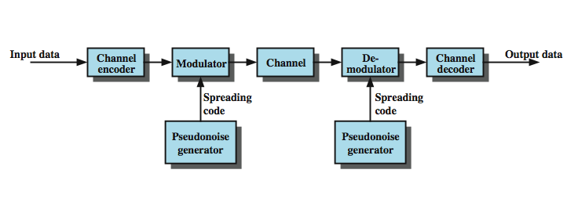
General Model of Spread Spectrum System
Notes:
Stallings DCC8e Figure 9.1 highlights the key characteristics of any spread spectrum system. Input is fed into a channel encoder that produces an analog signal with a relatively narrow bandwidth around some center frequency. This signal is further modulated using a sequence of digits known as a spreading code or spreading sequence. Typically, but not always, the spreading code is generated by a pseudonoise, or pseudorandom number, generator. The effect of this modulation is to increase significantly the bandwidth (spread the spectrum) of the signal to be transmitted. On the receiving end, the same digit sequence is used to demodulate the spread spectrum signal. Finally, the signal is fed into a channel decoder to recover the data.

Slide 4
Spread Spectrum Advantages
immunity from noise and multipath distortion
can hide / encrypt signals
several users can share same higher bandwidth with little interference
  CDM/CDMA Mobile telephones
Notes:
Several advantages can be gained from this apparent waste of spectrum by this approach:
• The signals gains immunity from various kinds of noise and multipath distortion. The earliest applications of spread spectrum were military, where it was used for its immunity to jamming.
• It can also be used for hiding and encrypting signals. Only a recipient who knows the spreading code can recover the encoded information.
• Several users can independently use the same higher bandwidth with very little interference. This property is used in cellular telephony applications, with a technique know as code division multiplexing (CDM) or code division multiple access (CDMA).

Slide 5
INTRODUCTION TO SIMULINK
Simulink is a software package for modeling, simulating, and analyzing dynamical systems.
For modeling, Simulink provides a graphical user interface (GUI) for building models as block diagrams, using click-and-drag mouse operations.

Slide 6
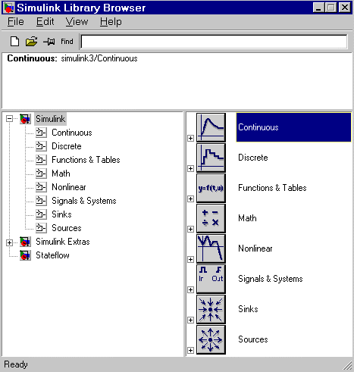
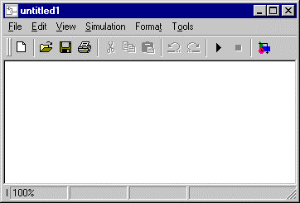
Simulink Library
Simulink opens a new model window

Slide 7
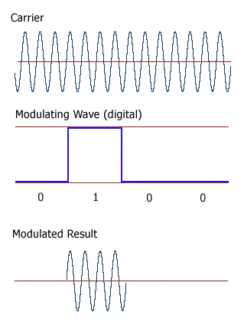
Amplitude Shift Keying(ASK)]
Amplitude Shift keying(ASK) is the simplest digital modulation technique . In this method, there is only one unit energy carrier and it is switched on or off depending upon the input binary form.

Slide 8
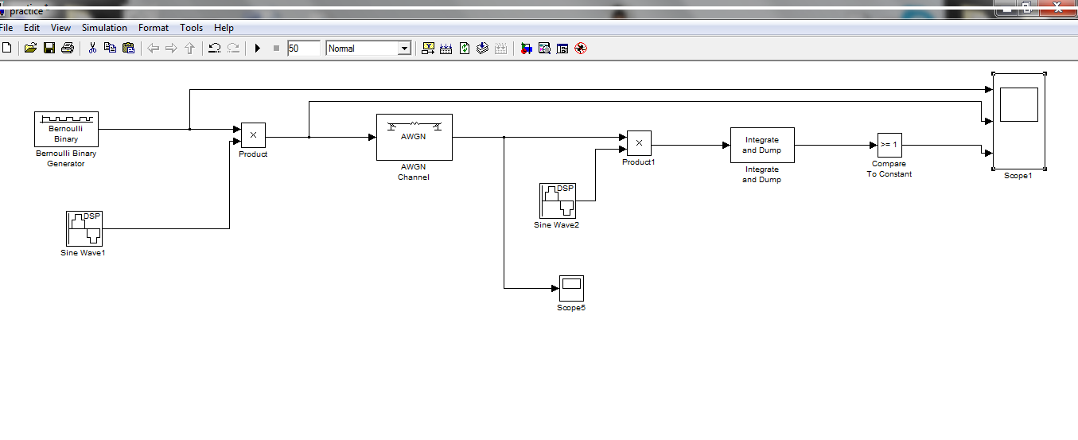
ASK Simulink Block Diagram

Slide 9
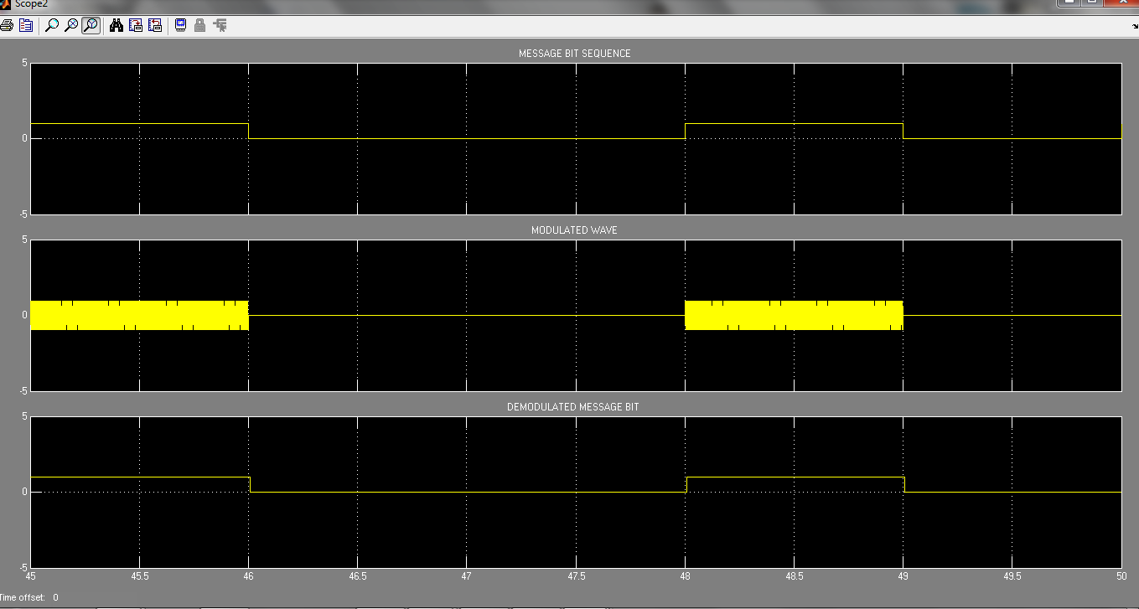
ASK Waveform

Slide 10
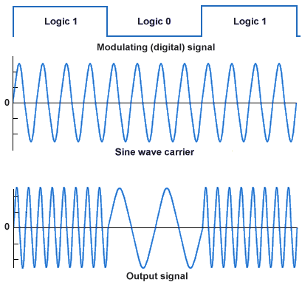
Frequency Shift Keying(FSK)
In binary frequency shift keying, the frequency of a sinusoidal carrier is shifted according to binary symbol .The phase of the carrier is unaffected .This means that we have two different frequency signal according to binary signal.

Slide 11
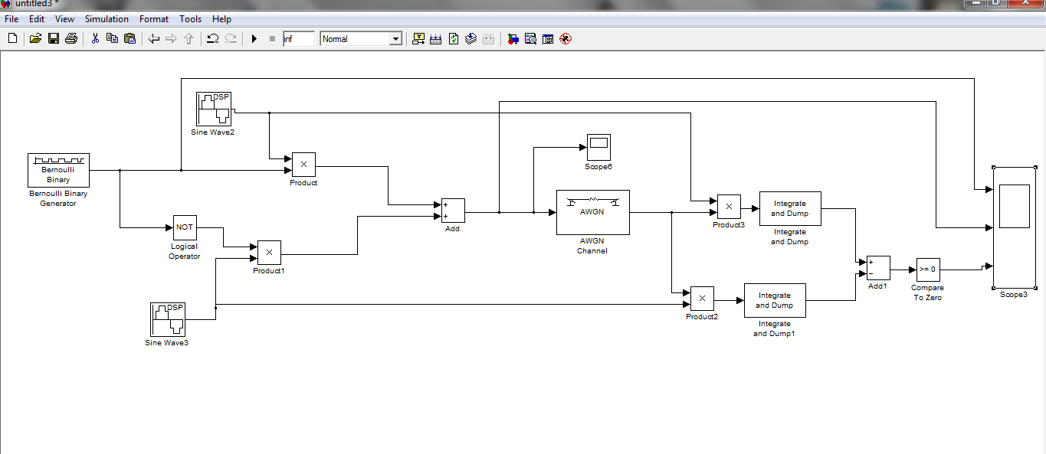
BFSK Simulink Block Diagram

Slide 12
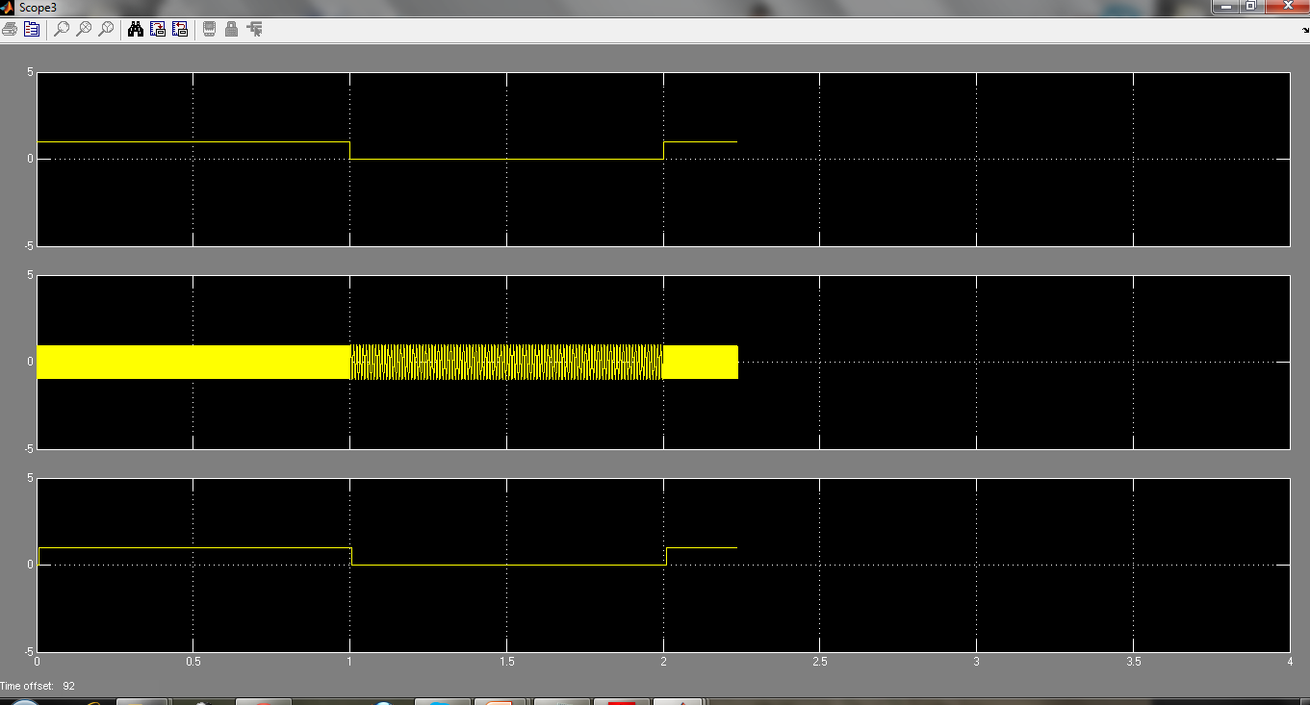
BFSK Waveform

Slide 13
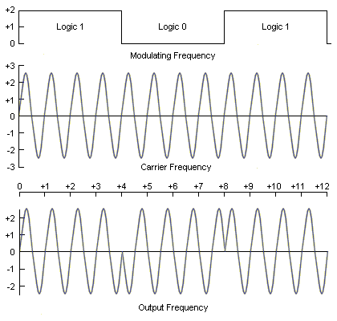
Phase Shift Keying(PSK)
Phase shift keying is a way of transmitting information. This is done by modulating the phase of a carrier wave. In such a system, the amplitude of the wave does not carry any information; all information is present in the phase of the signal. In many cases, this allows to better use the bandwidth available.

Slide 14
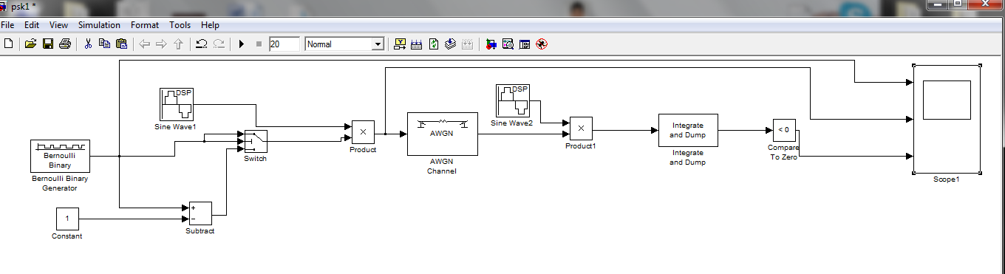
BPSK Simulink Block Diagram

Slide 15
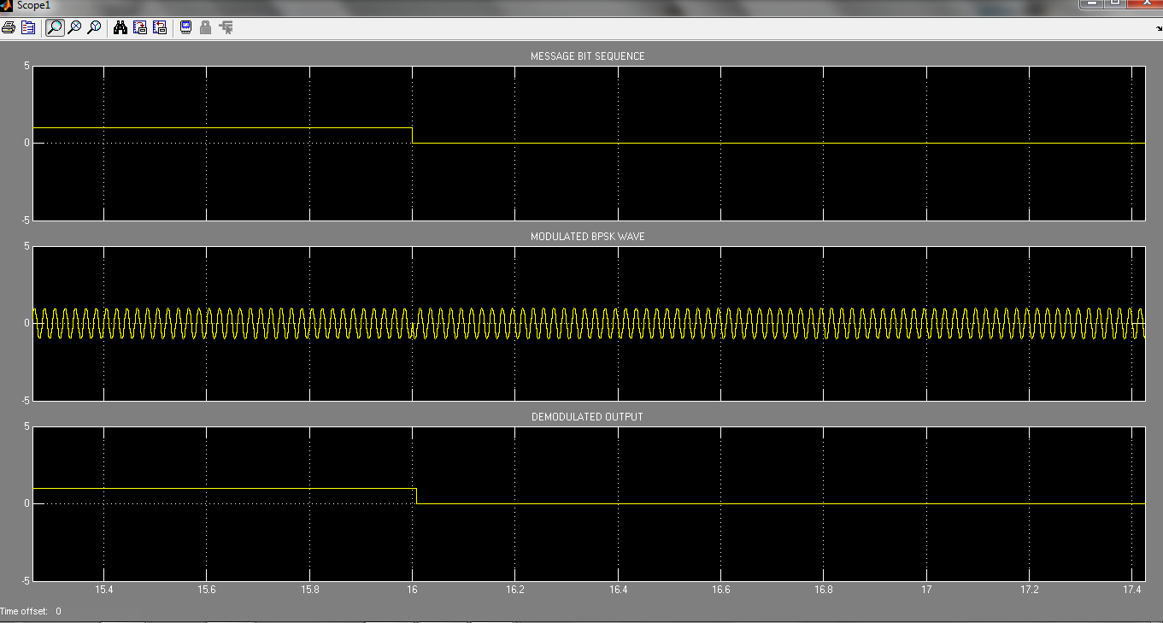
BPSK Waveform

Slide 16
Future Work
Till now we have only done the block diagram of some digital modulation technique using Simulink. But our main aim is to analyze the performance of spread spectrum communication system. So in our next semester we will continue our work in Simulink plat form and check the bit error, efficiency and interference of the transmitted and received decoded signal. We also compare the performance using different modulation techniques.
We have only used Simulink platform but we are interested in MATLAB programming to check the performance . So our next work is also use matlab program .

Slide 17
As spread spectrum is very useful in today’s wireless technology and we know that here more than one modulated signal is transmitted through one channel, so in future we will use same channel for sending more signals and also check if there is any interference occur between the signals when decode it. And if interference will occur then we will try to solve that.

Slide 18
References
Communication System by Sanjay Sharma.
Fundamentals of Communication System by John G. Proakis & Masoud Salehi.
MATLAB & Simulink For Engineers by Agam Kumar Tyagi.
Wikipedia.
Software used MATLAB R2008a.

Slide 19


